Slide 1
BINU.S FINAL PROJECT
3/21/2024 Annual Review

Slide 2
PROJECT TITLE : TRAFFIC SIGN RECOGNITION USING CNN AND KERAS
3/21/2024 Annual Review

Slide 3


AGENDA
Problem Statement
Project Overview
End Users
Our solution and Proposition
Key Features
Modelling Approach
Results and Evaluation
Conclusion
3/21/2024 Annual Review

Slide 4

PROBLEM STATEMENT
Devolop an effective traffic sign recognition systems utilizing convolution neural networks in (CNN) and Keras
3/21/2024 Annual Review

Slide 5
PROJECT OVERVIEW
Implementing a real-time traffic sign recognition system using Convolutional Neural Networks (CNNs) holds immense importance across various domains such as Autonomous Vehicles, Advanced Driver-Assistance Systems (ADAS), Smart Surveillance Systems, Industrial Automation, Robotics
Their ability to automatically learn hierarchical features from images makes them well-suited for tasks like traffic sign recognition
Real-time traffic sign recognition includes challenges such as speed,accuracy,robustness.
CNNs are highly relevant in traffic sign recognition tasks due to their capability to automatically learn discriminative features from images, minimizing errors in detection
3/21/2024 Annual Review

Slide 6

WHO ARE THE END USERS?
.
Automobile Manufacturers
Transportation Authorities
Smart City Initiativesla
Commercial Fleet Operators
Research and Development
Navigation and Mapping Services
Law Enforcement
3/21/2024 Annual Review

Slide 7

YOUR SOLUTION AND ITS VALUE PROPOSITION
Solution :
These models are designed to effectively capture intricate patterns and features inherent in traffic signs, ensuring high accuracy and reliability in classification.
The curate and preprocess a comprehensive dataset comprising a diverse range of traffic sign images and this diverse dataset enables our model to generalize well and perform effectively in real-world scenarios.
Our solution is designed for seamless integration with existing automotive platforms, navigation systems, and smart city infrastructure
Value proposition :
Enhanced Safety: By accurately recognizing and interpreting traffic signs in real-time, our system assists drivers in adhering to traffic regulations, reducing the risk of accidents and improving overall road safety.
Improved Efficiency: Automated detection and classification of traffic signs streamline navigation and route planning, optimizing travel time and fuel consumption for individual drivers and commercial fleets.
3/21/2024 Annual Review

Slide 8

THE WOW IN YOUR SOLUTION
High Accuracy and Reliability: By leveraging state-of-the-art CNN architectures and meticulous dataset curation, our solution achieves exceptional accuracy in traffic sign recognition, surpassing traditional methods.
Real-time Performance: Our system excels in real-time performance, swiftly analyzing live video streams from vehicle-mounted cameras to provide instantaneous feedback to drivers.
Seamless Integration and Scalability: Designed with seamless integration in mind, our solution effortlessly integrates with existing automotive platforms, navigation systems, and smart city infrastructure.
Enhanced Safety and Efficiency: By empowering drivers with timely information about traffic signs, our solution enhances safety by reducing the risk of accidents and violations.
3/21/2024 Annual Review
8

Slide 9
MODELLING
Data Collection: Begin by sourcing a diverse dataset of labeled traffic sign images from public repositories or by capturing images using cameras mounted on vehicles. Ensure the dataset covers a wide range of traffic sign types, variations, and environmental conditions.
Data Preprocessing: Clean and preprocess the dataset to standardize image sizes, normalize pixel values, and augment the dataset using techniques such as rotation, flipping, and cropping. Data augmentation helps increase the variability of the dataset and improves the model's ability to generalize.
Model Architecture Design: Design or select a suitable CNN architecture for traffic sign recognition. Consider architectures like LeNet, VGGNet, or custom-designed models optimized for the task. Pay attention to factors such as model depth, receptive field, and computational efficiency.
Model Training: Train the chosen CNN model on the preprocessed dataset using Keras and TensorFlow. Split the dataset into training, validation, and test sets to assess the model's performance. Train the model using techniques like mini-batch stochastic gradient descent (SGD) with adaptive learning rate algorithms such as Adam.
3/21/2024 Annual Review
9

Slide 10
MODELLING
Model Evaluation: Evaluate the trained model's performance on the validation and test sets using metrics such as accuracy, precision, recall, and F1-score. Analyze the model's confusion matrix to understand its strengths and weaknesses in recognizing different traffic sign classes.
Hyperparameter Tuning: Fine-tune the model's hyperparameters, including learning rate, batch size, dropout rate, and kernel size, to optimize its performance. Use techniques like grid search or random search to explore the hyperparameter space efficiently.
Deployment: Deploy the trained model into real-world applications, such as autonomous vehicles, advanced driver assistance systems (ADAS), or traffic monitoring cameras. Optimize the model for inference speed and memory footprint, considering hardware constraints of the target deployment environment.
Monitoring and Maintenance: Continuously monitor the deployed model's performance in production to detect any degradation or drift. Implement mechanisms for automatic retraining using fresh data or periodic model updates to ensure its effectiveness over time. Collaborate with domain experts and stakeholders to address emerging challenges and improve the system iteratively.
3/21/2024 Annual Review
10

Slide 11
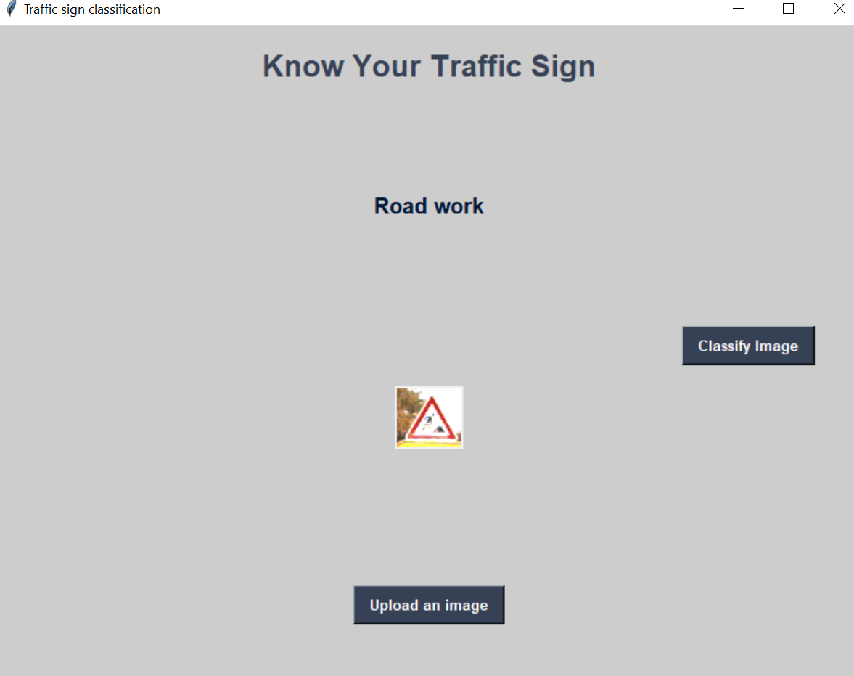
RESULTS
3/21/2024 Annual Review
11

